Slide 1
Software Engineering and Architecture
Design Patterns and Lambda in Java8

Slide 2
My PhD Supervisor said…
Design patterns are just deficiencies in the underlying programming language. [Ole Lehrman Madsen]
There is some truth in that statement…
Let us have a look at Java8 and what it can do…

Slide 3

Lambda in Java 8
@FunctionalInterface
Annotation on an interface signalling that the interface has only one method and can thus be treated as a function
Any interface with only single abstract method is a functional interface
Read: The java compiler adds the annotation automatically…

Slide 4
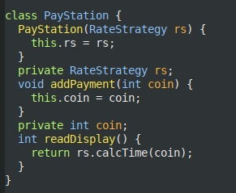
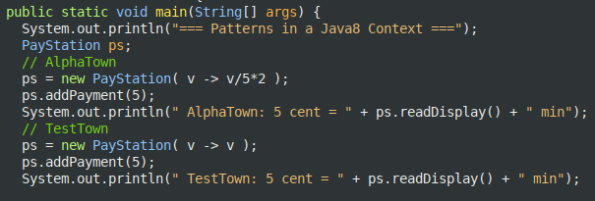
Strategy Pattern
Many Strategies express an algorithm in only a single method and can thus be expressed faster using lambda’s.

Slide 5
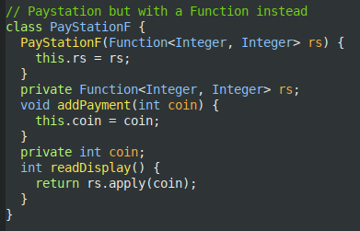

java.util.function
Our RateStrategy is just a f: x -> y
Refactor to use java.util.function.Function

Slide 6
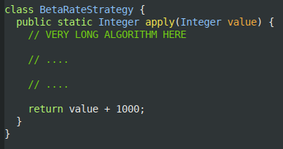

What about ‘large’ strategies?
BetaTown RateStrategy – many more lines of code…
You can use method references
BetaRateStrategy::apply
Quite a few ways of referring to functions, this is just one way…

Slide 7
Strategy
A strategy that just operates GameImpl methods
Consumer has single method
void accept(T t);
Ala
WorldLayoutStrategy implements Consumer<GameImpl>
Accept method would then call back to gameimpl and set up world.
So – should we remove all strategies and replace with these weird fellows???

Slide 8
Morale: Patterns are Communication
Maybe this is just mental enertia on my behalf, but…
Expressing the interfaces are explicit documentation…
I think you may loose some of that if your design just becomes a bunch of Function, Consumer, BiFunction, etc.
But – perhaps just a matter of training…

Slide 9
Command Pattern

Slide 10
Command Pattern
Command is the Pattern to convert an method invocation into an object.
But hey – that is the very definition of a lambda!
Function pointer – a reference to a specific method, that is a first class object to be handled explicitly by the language…
However, only really works for ‘execute()’ and not for ‘undo()’
Two methods in the Command interface means that is not a functional interface and cannot be considered a lambda.

Slide 11
Iterator
The objectification of iteration

Slide 12
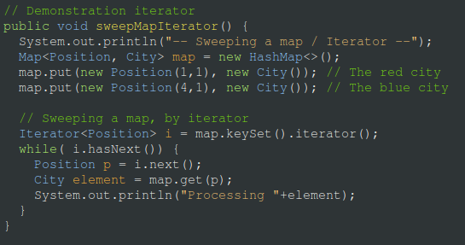
Java Iterator
Ask collection for its iterator, use that to visit every elem.

Slide 13
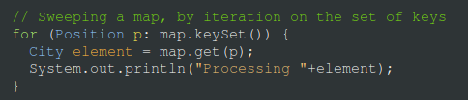
For each loop
This was cumbersome, so syntactic sugar was applied.
Both way, however is external iterators
The iterator ‘surrounds’ the collections

Slide 14
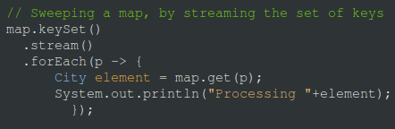
Streaming libraries
Lambda functions allow to just supply the collection with the ‘function to apply’ and then change to internal iteration

